Slide 2
What’s the Blueprint for Group Transport Success?
Speakers:
Jamisha Breland of AMAREN Transportation & Management
Erin Digioia of Windy City Limousine & Bus
Moderator: Tiffany Hinton of MOTEV
AV Sponsor
Coffee Sponsor

Slide 3
Welcome & Thank You to Our Sponsors
AV Sponsor
Coffee Sponsors

Slide 4
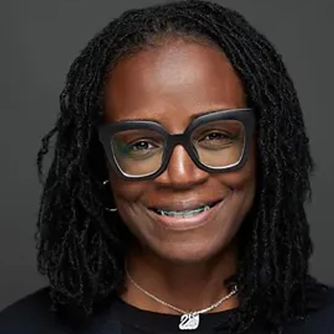
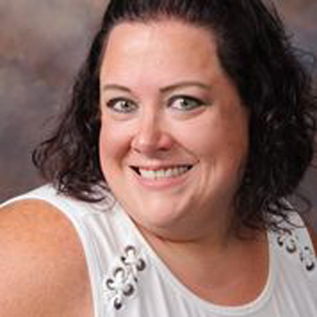
What’s the Blueprint for
Group Transport Success?
Jamisha Breland
Erin Digioia
AMAREN Transportation
& Management
Windy City
Limousine & Bus
AV Sponsor

Slide 5
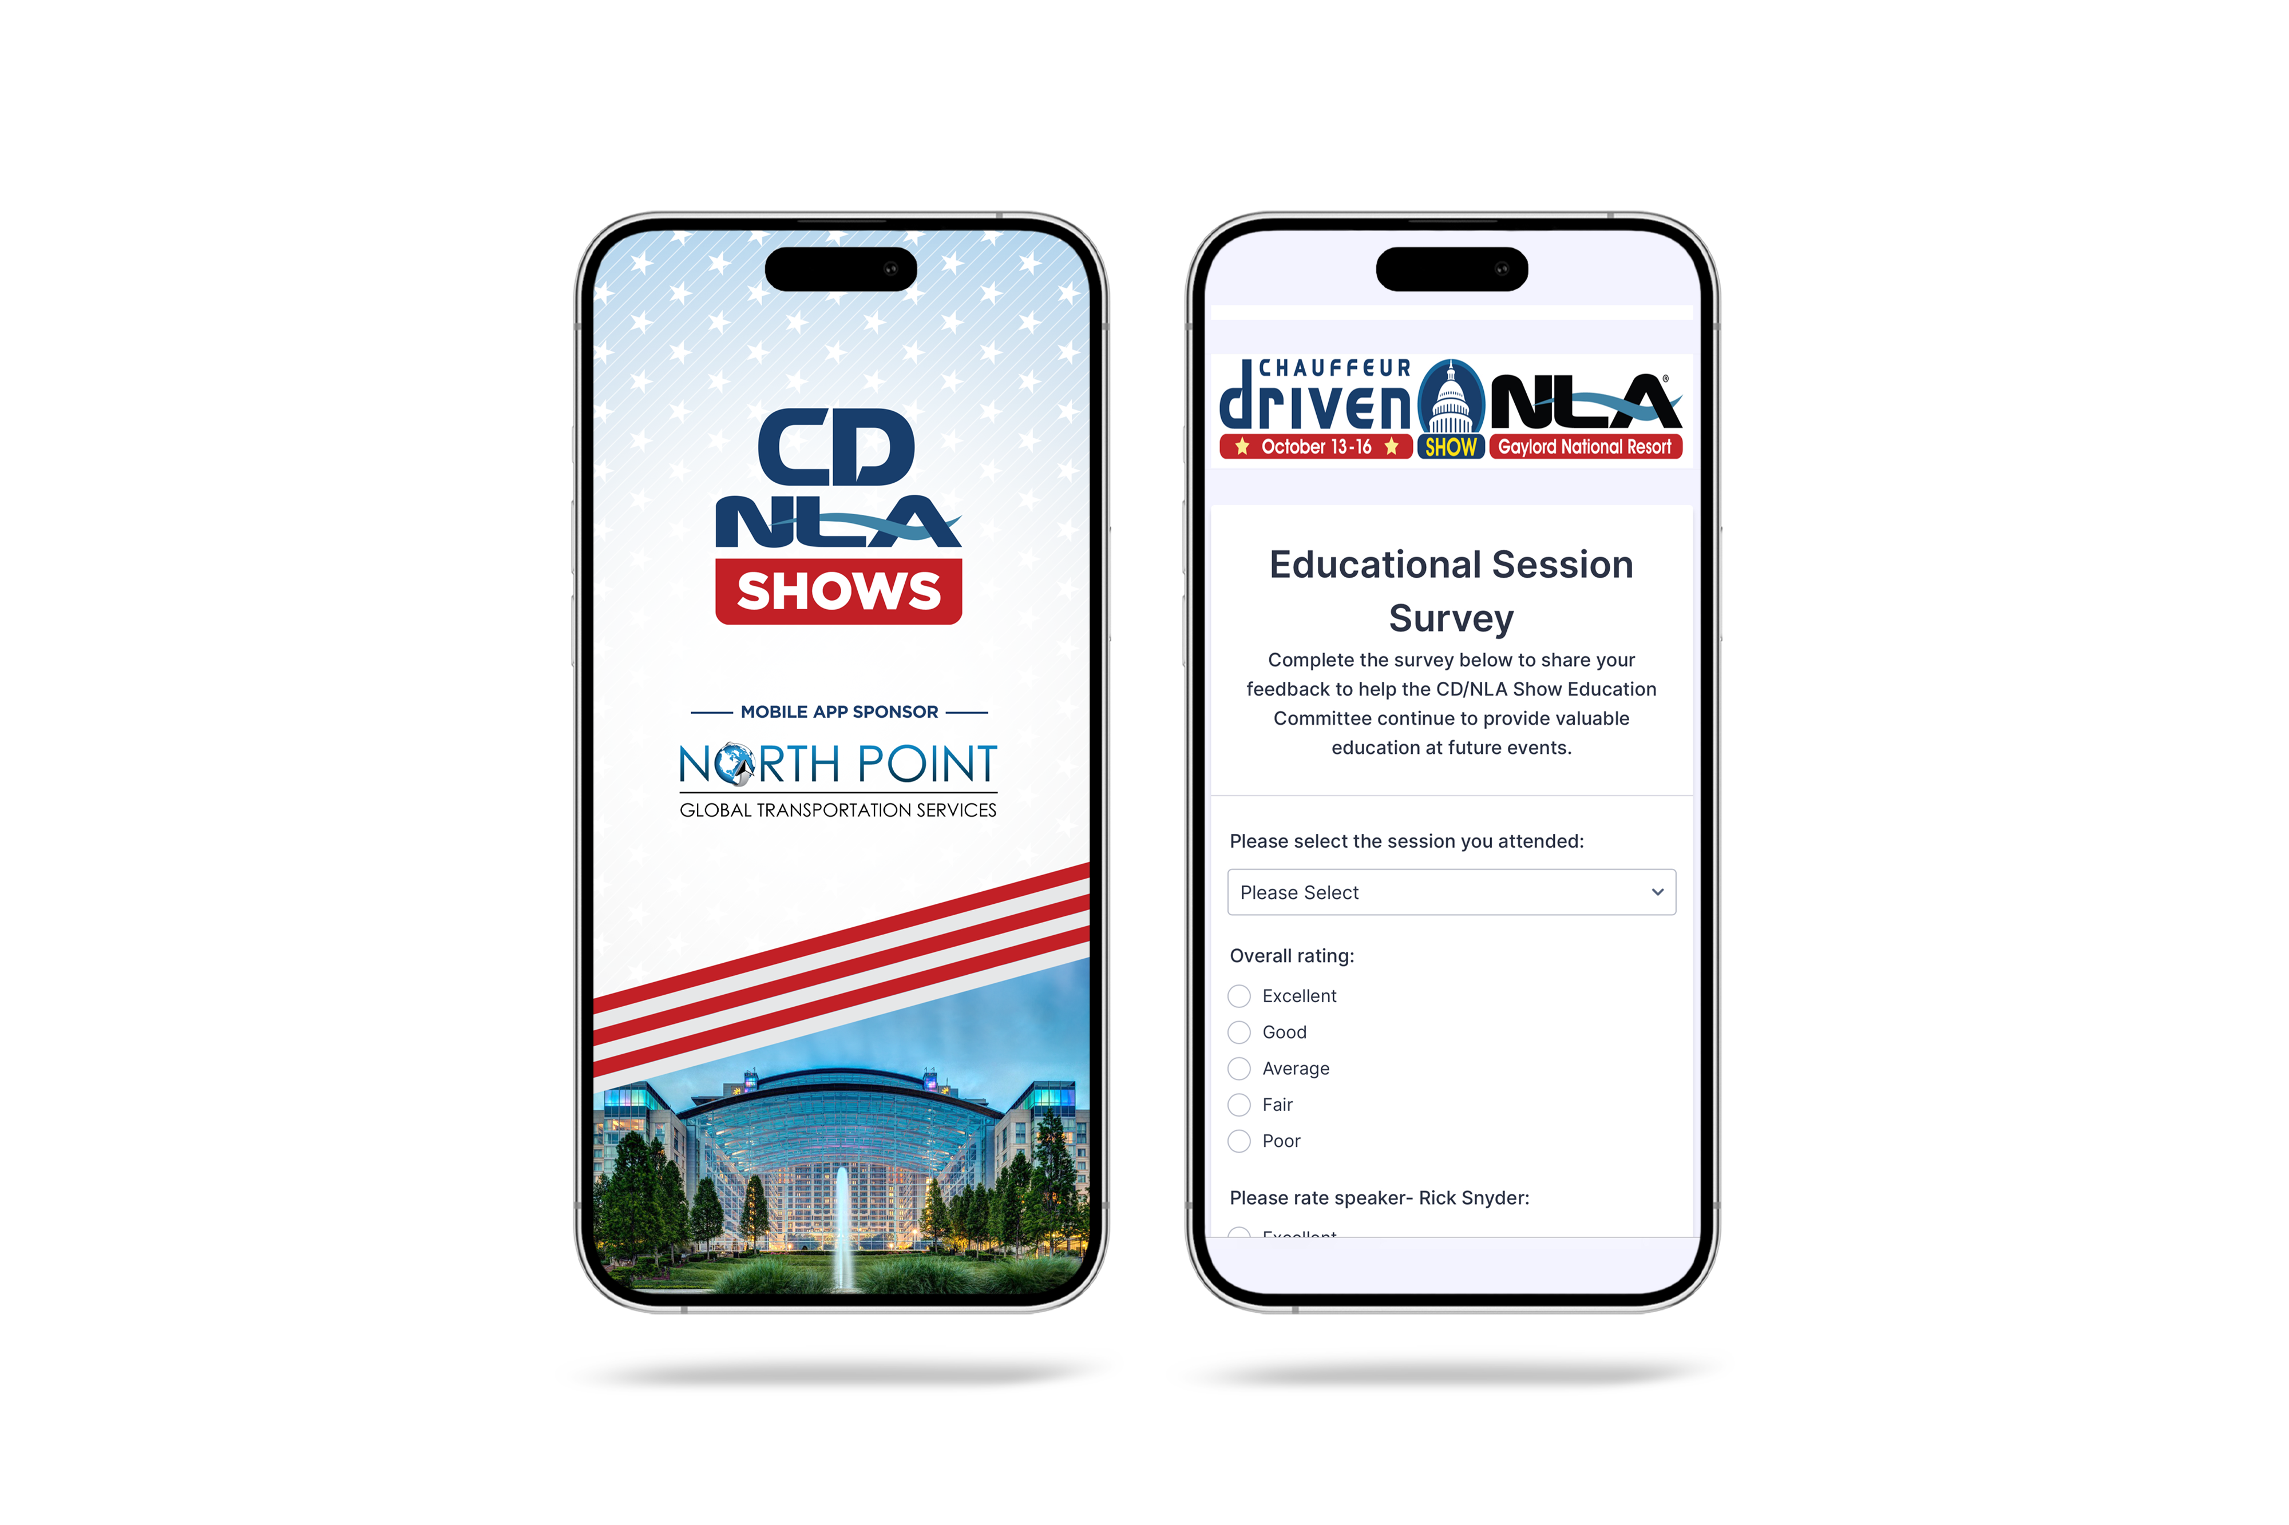
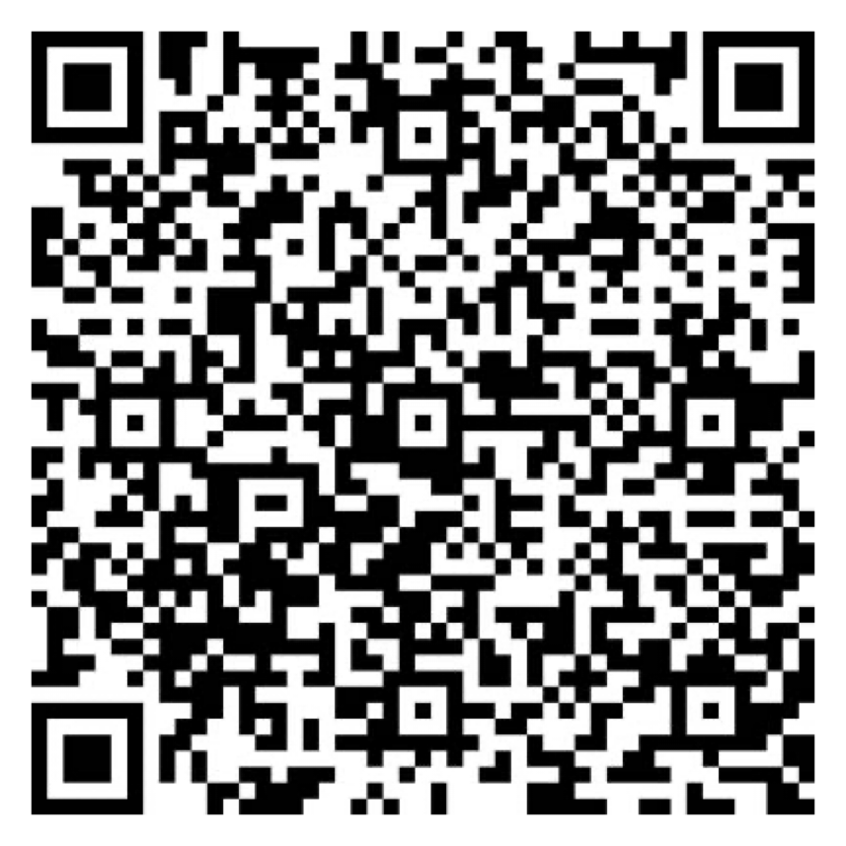
Let Us Know How
We Did!
Fill Out the Survey
AV Sponsor
Coffee Sponsor

Slide 6
Thank You for Joining Us!
AV Sponsor
Coffee Sponsor

